Slide 1
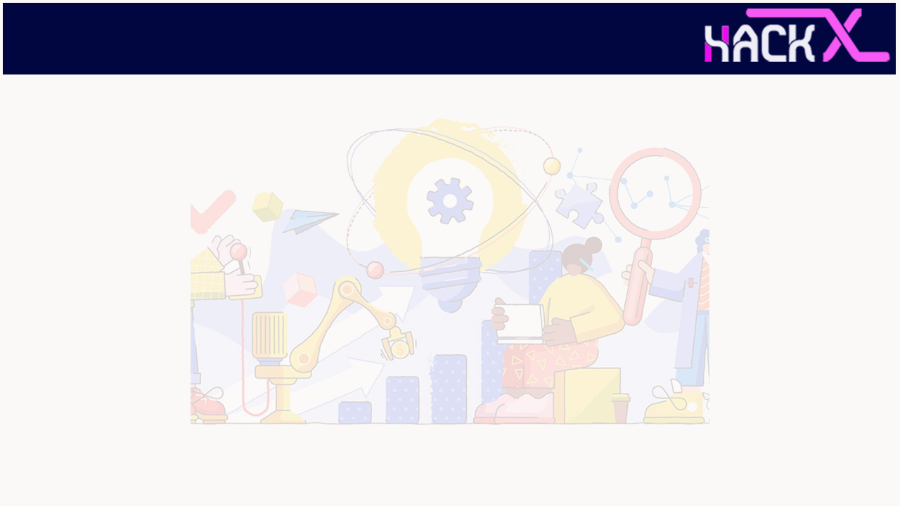
SLIDE 1
Team Name: 4O4NotFound
2. Members Name and Phone Numbers: Thaman Muthappa M N (Leader) – 9880093000, Neel Ghoshal - 9643791009
3. Domain name : Voice and Image Processing
4. Problem statement ( the problem you’re addressing ): Smart body posture recognition & Guiding system. This System is a self-service wellness KIOSK that measures health vital parameters like BMI, BMC, BP, ECG, Pulse rate, Temperature. And it should be designed to be non-assisted while the user measures the vitals. A right body posture yields a correct result. We want the system should capture the image of the used body posture like a hand, leg, etc via camera and through image processing; Compare the required postures for a particular test, Analyse and guide users to have the right posture in case the test is not carried out proper.

Slide 2
SLIDE 2
ABSTRACT:
Work-in
Work-in is an embedded fitness software designed to allow users to easily and efficiently do their fitness regimes efficiently and have a correct score of how many reps they did. The software is meant to allow users to remain fit in this pandemic period and would allow them to easily follow up with their goals.

Slide 3
SLIDE 3
NOVELTY
Our software would be novel in the fitness industry. We will provide users with a full fledged workout regime which they can easily follow without any trainers or external help. Users will have a very new outlook with regard to home fitness.

Slide 4
SLIDE 4
TECHNOLOGY
STACK
Python
OpenCV
Mediapipe
Jupyter

Slide 5
SLIDE 5
HARDWARE / SOFTWARE IMPLEMENTATION
Firstly we analyse the joints using mediapipe drawing specs. Then, we process the pose (curls) with the join, by calculating the angle between the joints. Then, we count the number of times the user has correctly executed the routine.

Slide 6
SLIDE 6
BUSINESS SCOPE
Due to the ongoing pandemic, a lot of gyms and other means of exercise have been shut down, this had led to people losing shape and becoming unhealthy. We at (enter name here), aim to solve this problem with this simple application using which the user can figure out if he/she is doing an exercise routine properly without the need of a personal trainer.
We also aim to keep several analytical tools to help the user figure out, in what areas, he/she needs, to work upon.
From a financial standpoint users could pay a nominal monthly or yearly subscription to make use of our services.

Slide 7
Maximum 8 Slides

